Slide 1
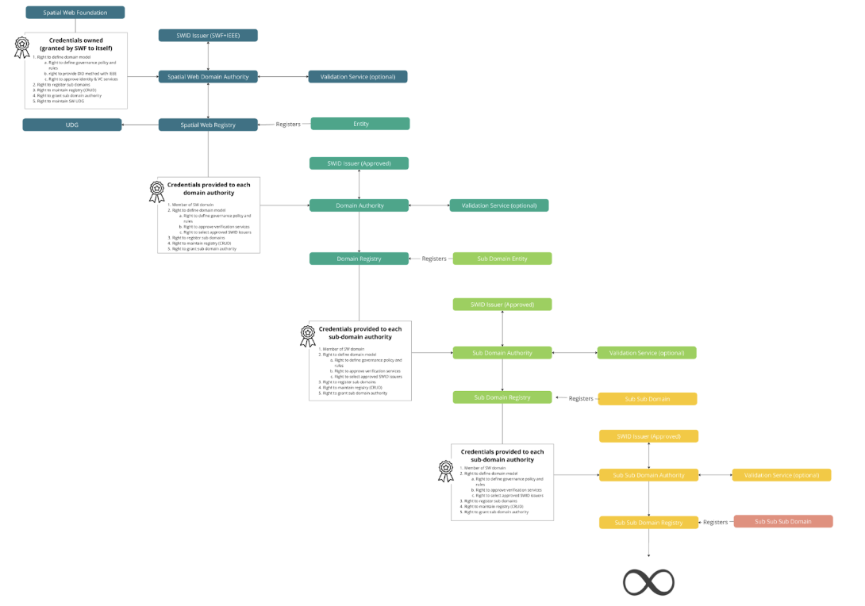
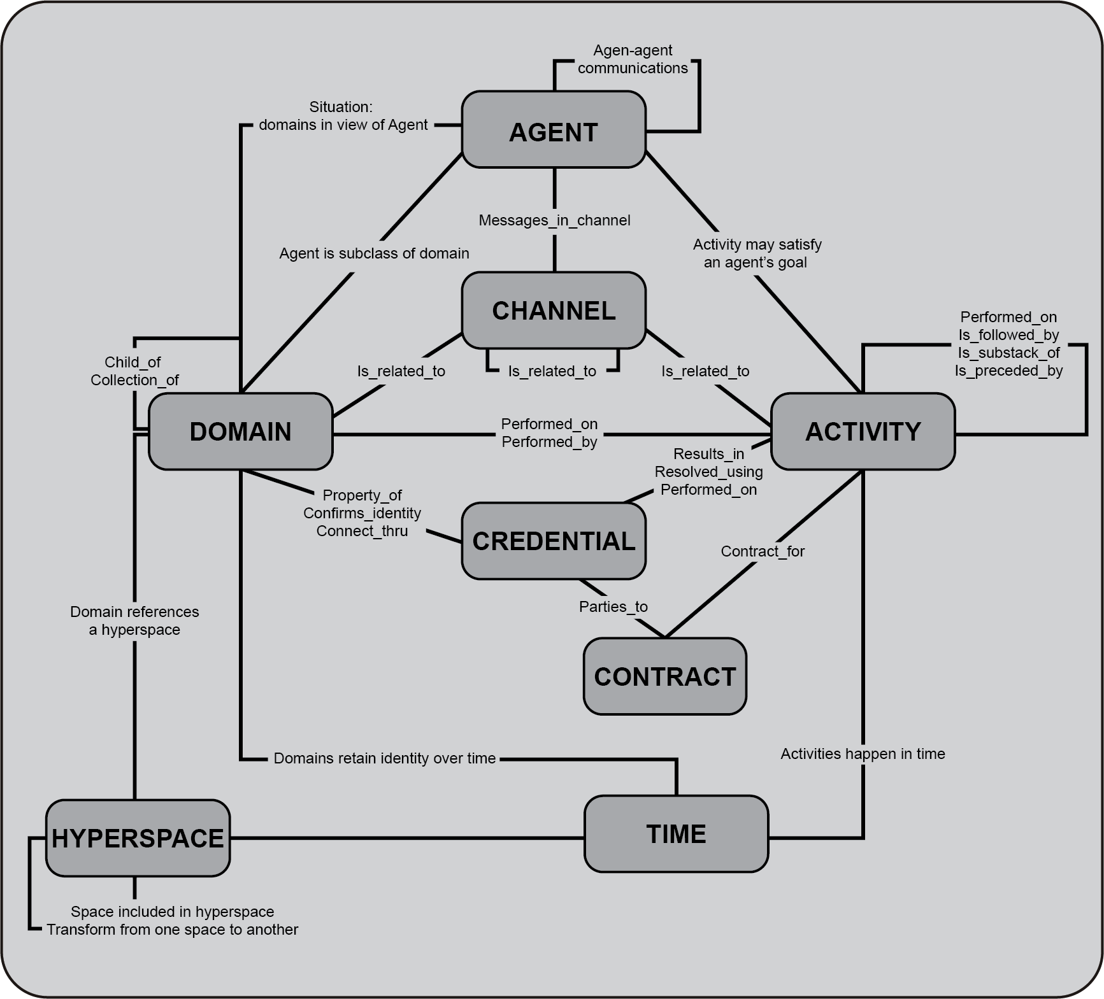
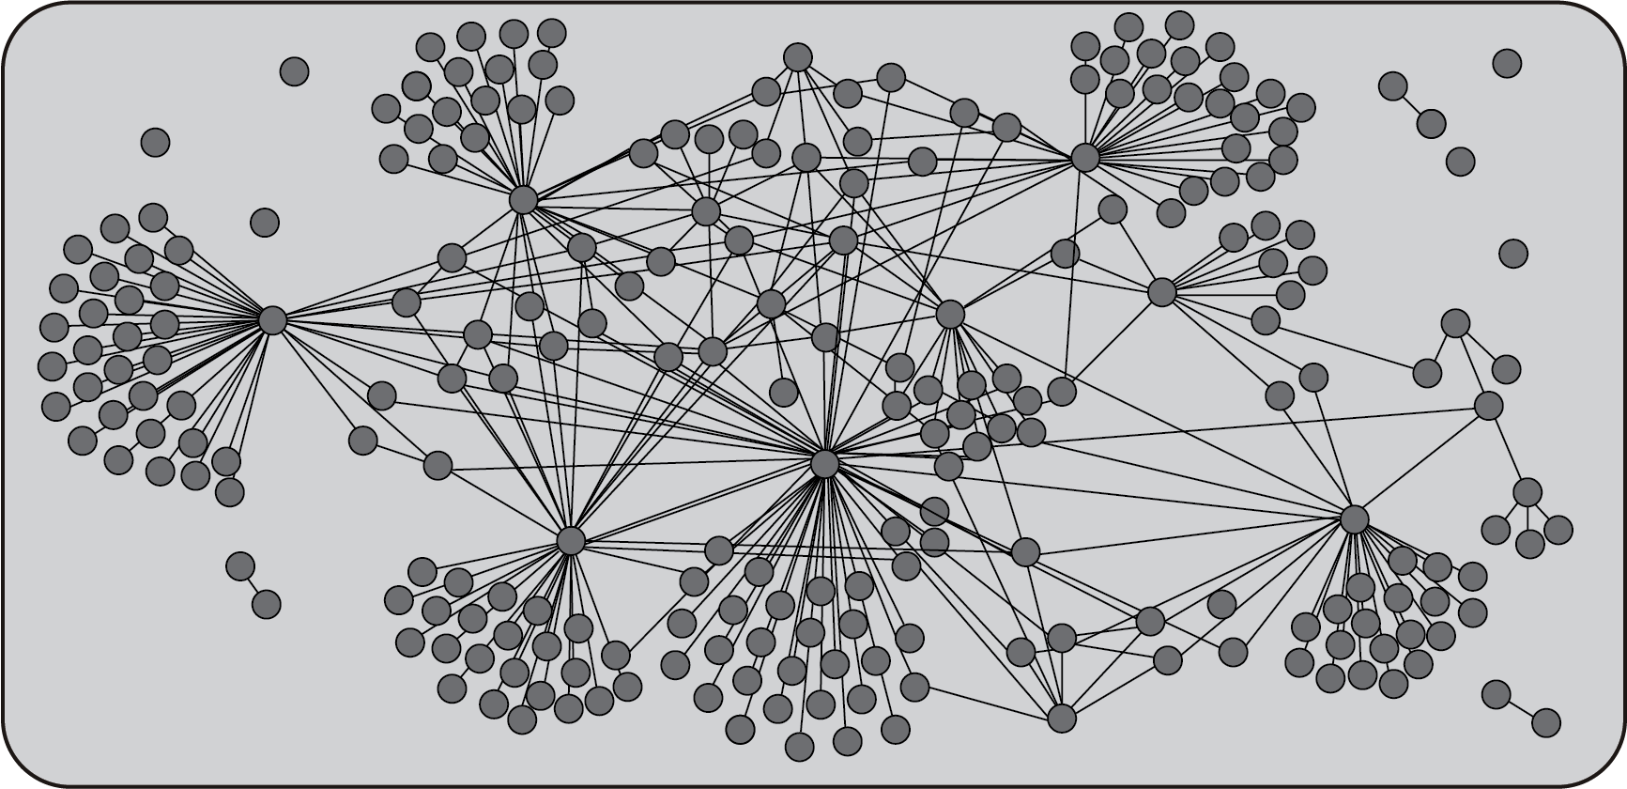
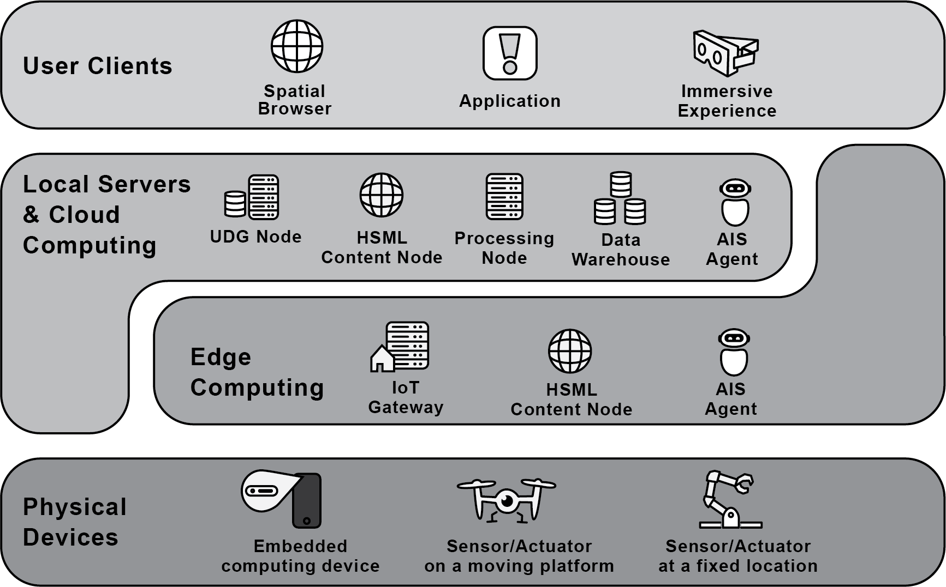
Conceptual views: KG, Social, Registry
Enterprise OV-1
Conceptual content hosted on SW nodes
Distrbuted Computing View: SW nodes, HSTP

Slide 2
UDG Graph of sw entities

Slide 3
Registries in the UDG

Slide 4
UDG social network
Daigram from Pentland

Slide 5
Deployment

